Slide 1


YOUTUBE COMMENT SPAM AND HAM DETECTION
April 12th, 2022
This Photo by Unknown author is licensed under CC BY-NC-ND.
This Photo by Unknown author is licensed under CC BY-NC.

Slide 2
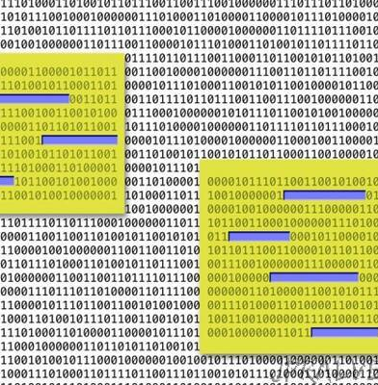
SUMMARY
"Bag of words" language model & the Navie Bayes classifier
Preparing Data (explain it)
Loading data
Training Dataset.
Training model with Naive Bayes classifier
Explain Results
Demonstrate the output (new comments)
Conclusions
This Photo by Unknown author is licensed under CC BY-NC-ND.

Slide 3
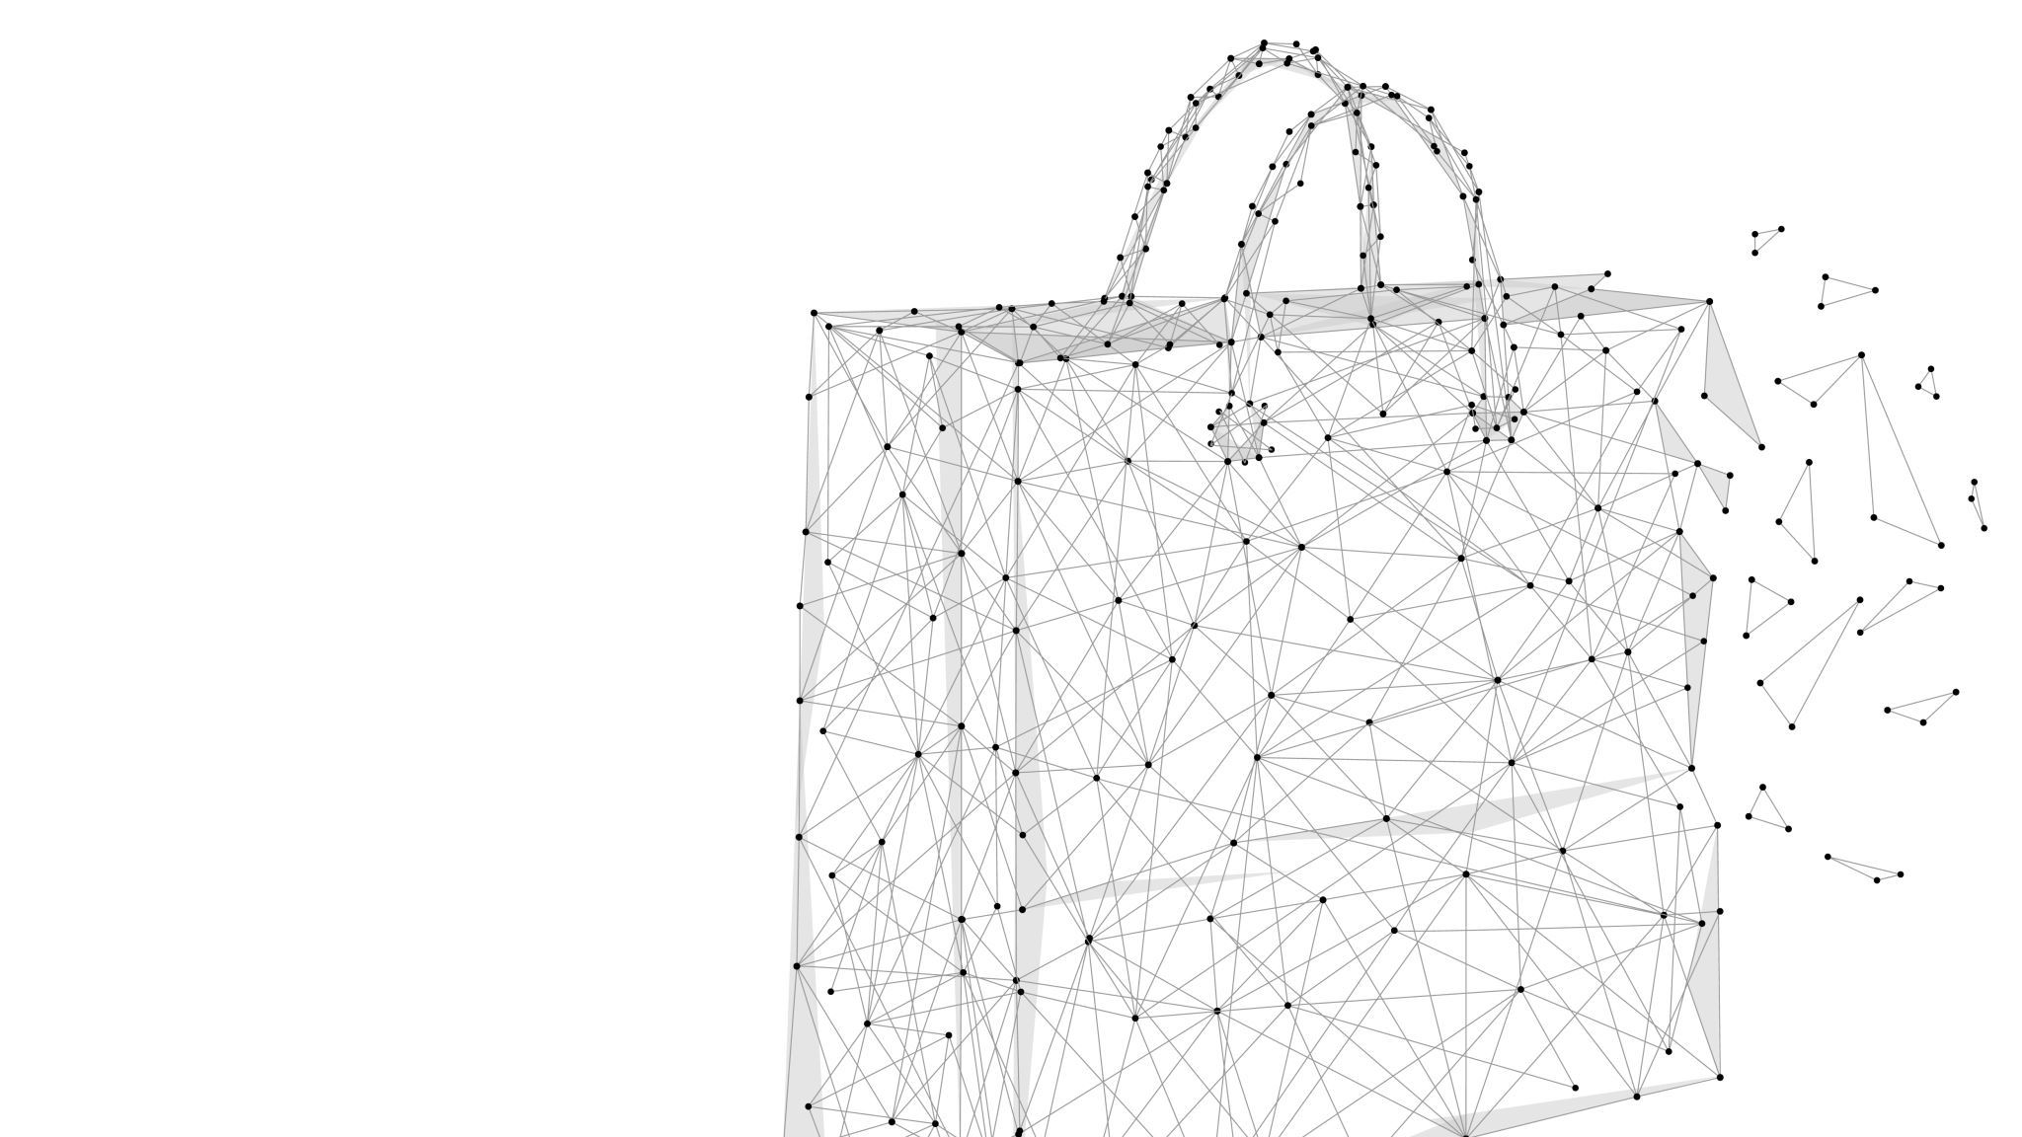
"Bag of words" language model & the Navie Bayes classifier
Explain both

Slide 4
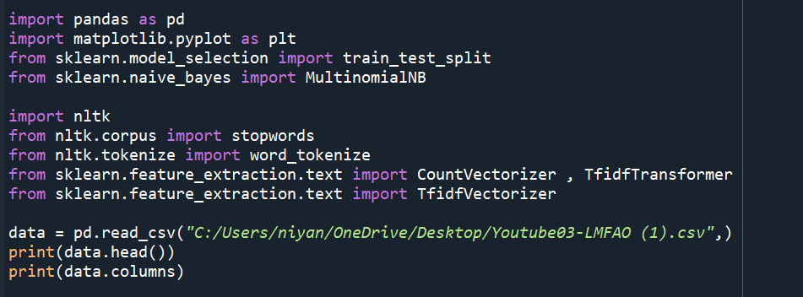
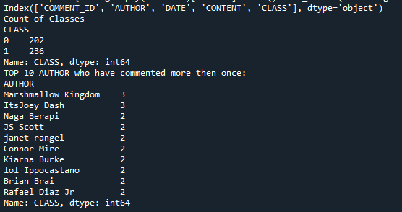
Loading Data

Slide 5
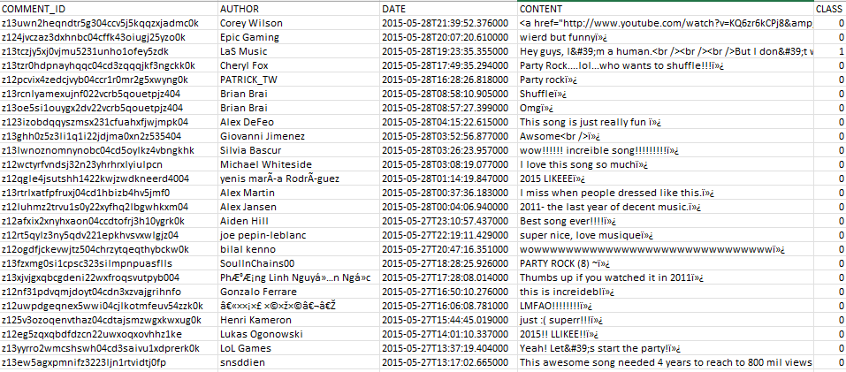
Data input

Slide 6
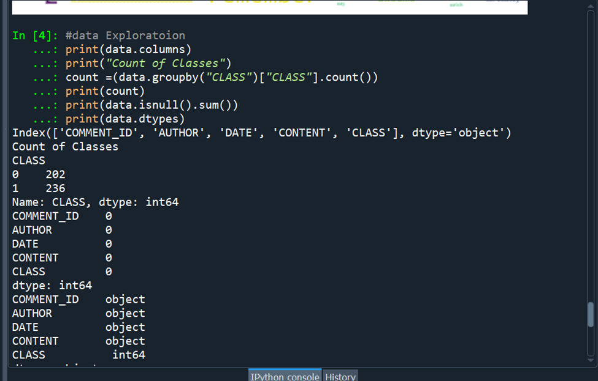
Basic data exploration

Slide 7
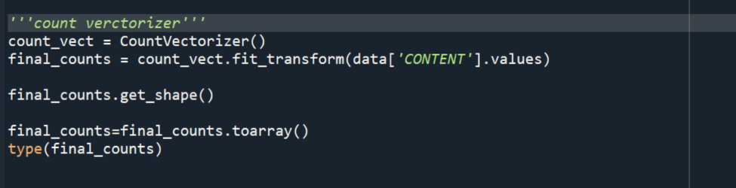
Preparing Data for Model Building (nltk toolkit )

Slide 8
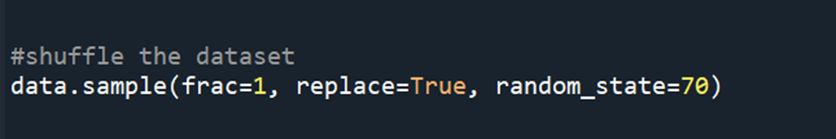
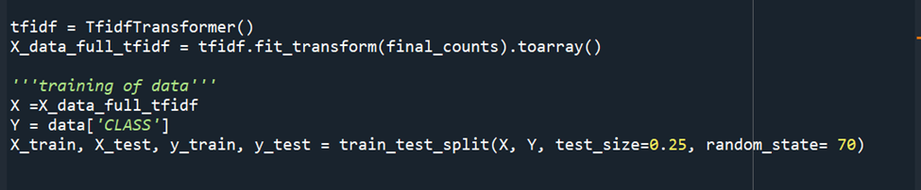
Training the Dataset & highlights of the output

Slide 9
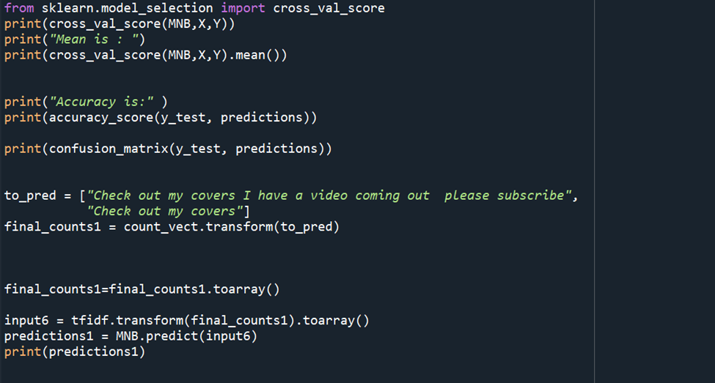
Naive Bayes classifier

Slide 10
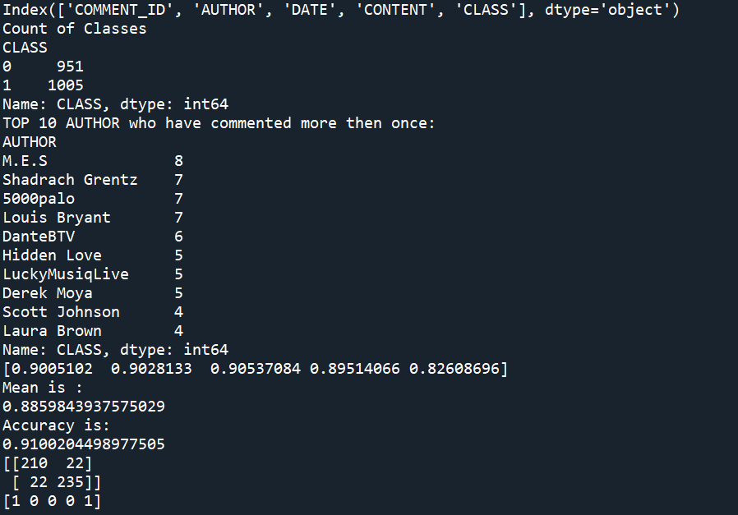
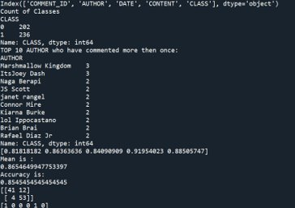
Model improvement results

Slide 11
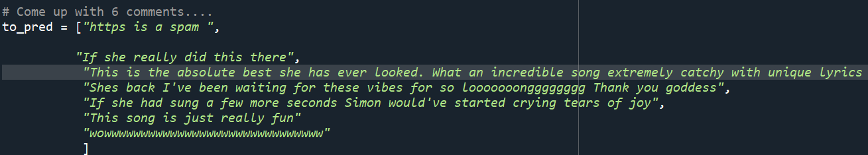
EXAMPLES

Slide 12
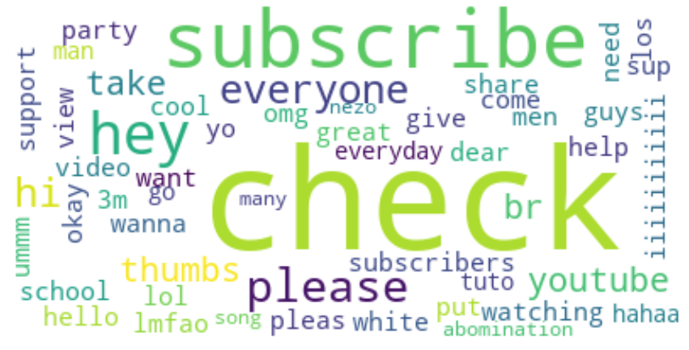
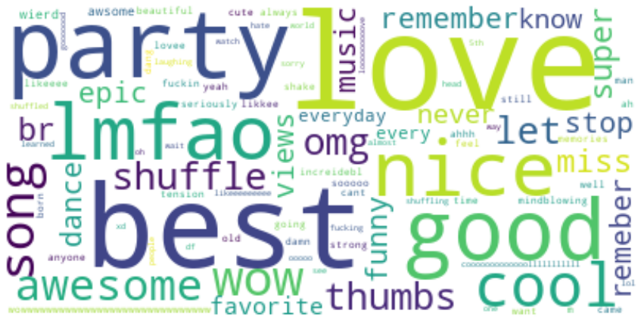
RESULTS
SPAM
REAL COMMENTS

Slide 13

CONCLUSION
The given data is slightly unbalanced
Only columns CLASS and "Content " are relevant.
Most of the people have commented only once.

Slide 14
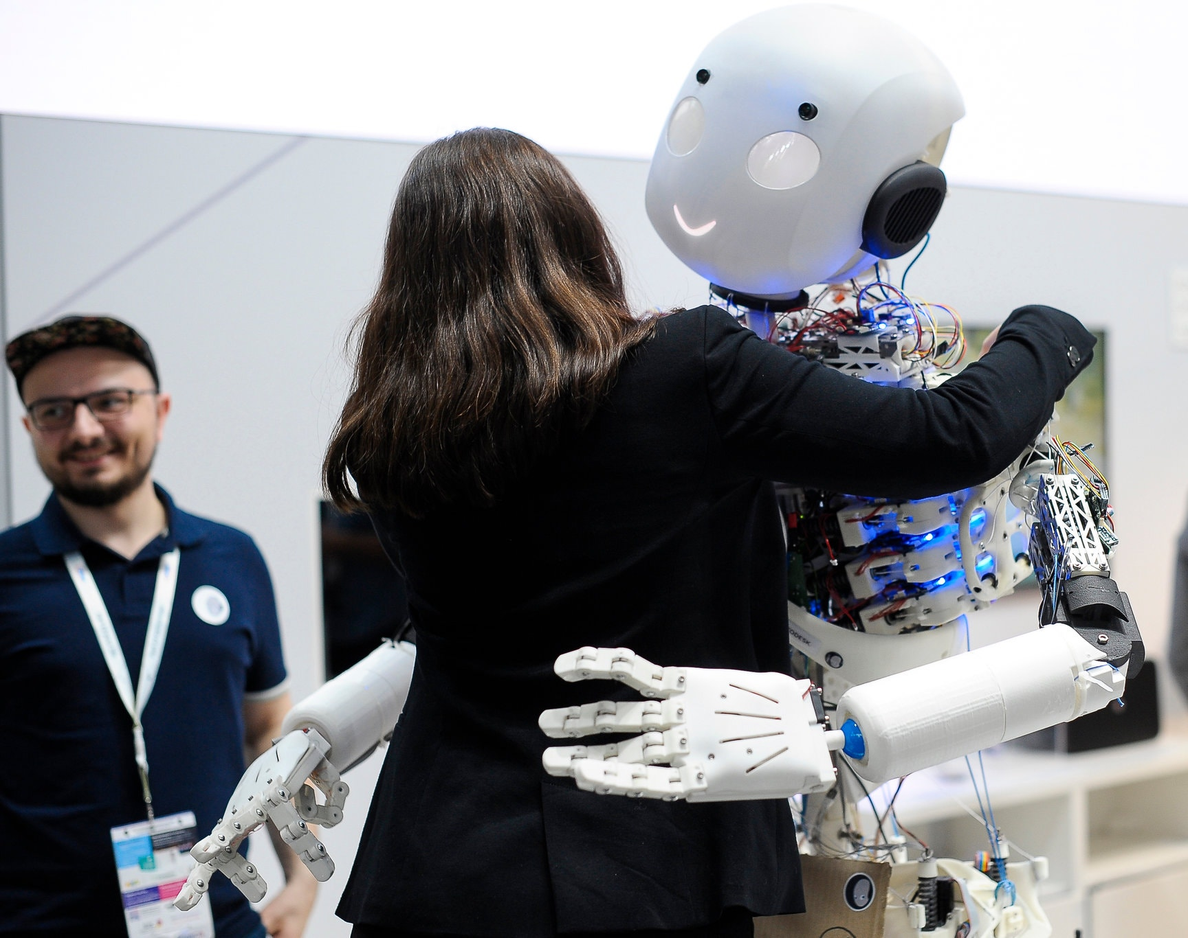
THANK YOU
This Photo by Unknown author is licensed under CC BY-SA-NC.

